Slide 1
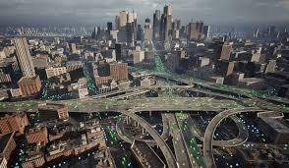
Optimization of High-traffic
Data Scientist Presentation by Rajveer Singh

Slide 2
Project Overview
Current challenge:
Homepage recipes are currently selected manually
Popular recipes can increase site traffic by up to 40%
More traffic can lead to more subscriptions
Business questions:
Can we predict which recipes will lead to high traffic?
Can we correctly identify high-traffic recipes at least 80% of the time?

Slide 3
Data and preparation
Data cleaning:
No duplicate rows found
Removed extreme outliers in nutritional columns using the IQR rule
Imputed remaining missing numerical values with the median
Standardised category labels
Cleaned servings values
Converted high_traffic into a binary target variable
Dataset included:
Calories
Carbohydrate
Sugar
Protein
Category
Servings
High traffic

Slide 4
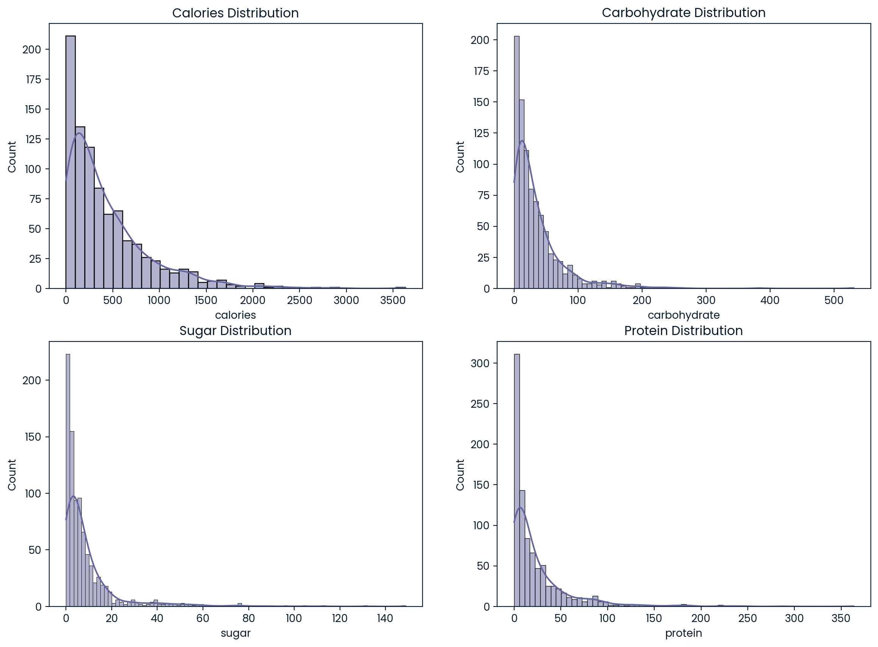
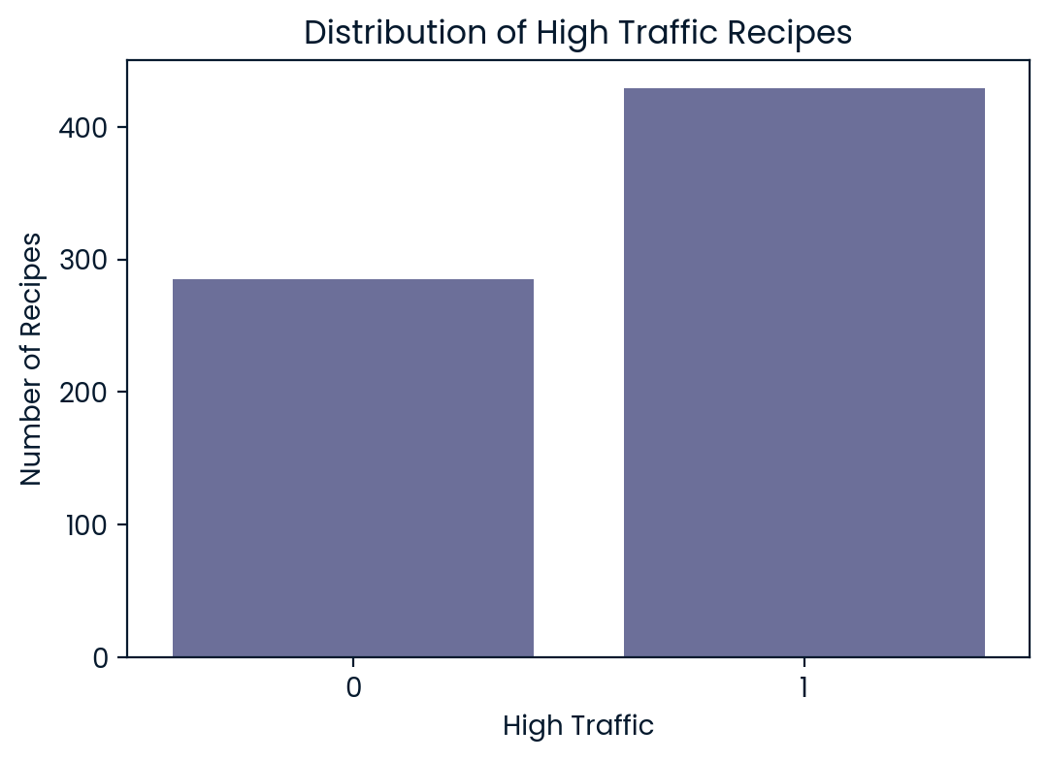
Exploratory analysis
Key findings:
Nutritional variables were strongly right-skewed
Most recipes had relatively low nutritional values with a long tail of larger values
60.1% of recipes were labelled high traffic
The target variable was reasonably balanced

Slide 5
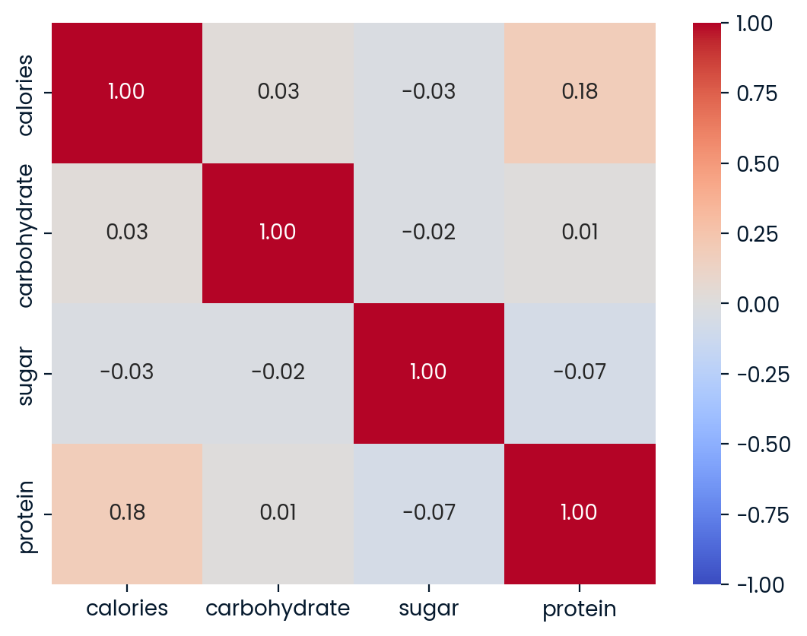

Key drivers of high traffic
Statistical findings:
Weak correlations between nutritional variables
Mann-Whitney U tests showed calories and protein were significantly different between high- and low-traffic recipes
Chi-square testing showed category was significantly associated with high traffic
Most important predictors:
Category was the strongest overall predictor
Calories and protein were the strongest numerical predictors

Slide 6
Model development
Problem type
Binary classification
Models used
Baseline: Logistic Regression
Comparison: Tuned Random Forest
Why these models?
Logistic regression is simple and interpretable
Random forest captures more complex patterns
Comparing both tested whether added complexity improved performance

Slide 7
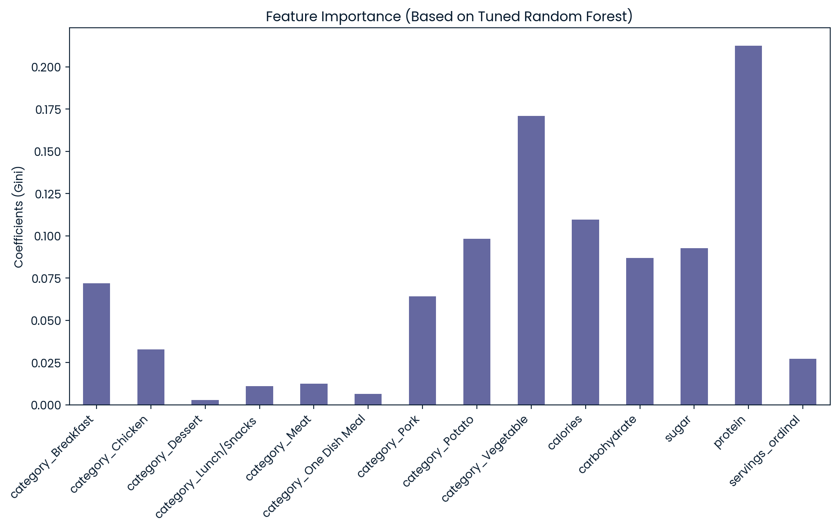
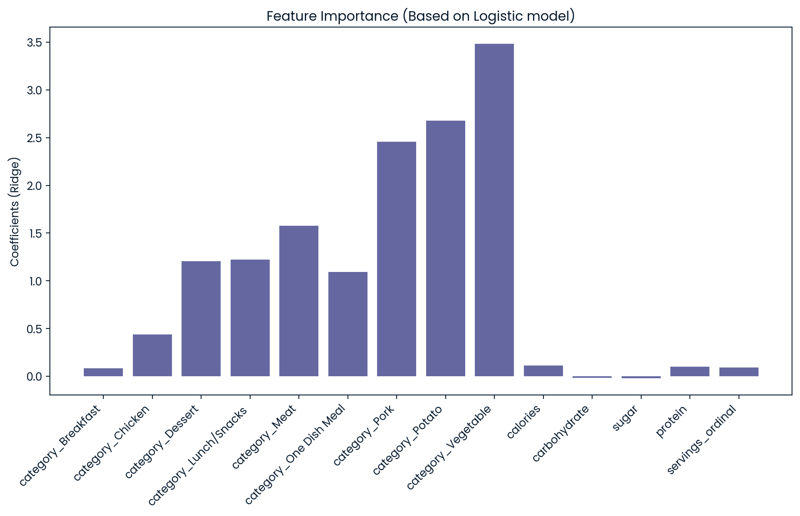


Model Results:
Key result:
Both models achieved the same accuracy
Logistic regression performed slightly better on ROC AUC and precision
Logistic regression exceeded the business target of 80%
Random Forest Classifier
Logistic Regression

Slide 8
Recommendation and conclusion
Recommendation
Deploy the Logistic Regression model as a decision-support tool
Use it to rank candidate homepage recipes by predicted probability of high traffic
Prioritise strong-performing categories such as Vegetable and Potato
Monitor precision over time after deployment
Conclusion
High-traffic recipes can be predicted
The 80% target was achieved
A simple, interpretable model is sufficient for the current business need

